Slide 1
views

Slide 2
What are views?
Simply put, VIEWS are virtual tables .By virtual, we mean, the tables do not store any data of their own but display data stored in other tables.
In other words, VIEWS are nothing but SELECT Queries.

Slide 3
Views syntax
Create view `view name` as select statement;
"CREATE VIEW `view_name`" tells MySQL server to create a view object in the database named `view_name`
"AS SELECT statement" is the SQL statements to be packed in the views. It can be a SELECT statement can contain data from one table or multiple tables.

Slide 4
Eg:
CREATE VIEW ‘v_pricelist’ as select '00' AS `CODE`,`idata`.`BRCODE` AS `BRCODE`,`idata`.`ITEMCODE` AS `ITEMCODE`,`idata`.`PARTCODE` AS `PARTCODE`,`idata`.`RATE` AS `PRICE` from `idata` where ((`idata`.`CANCEL` = 'No') and (`idata`.`DOCDATE` = (select max(`i`.`DOCDATE`) from `idata` `i` where (`i`.`ITEMCODE` = `idata`.`ITEMCODE`))));

Slide 5
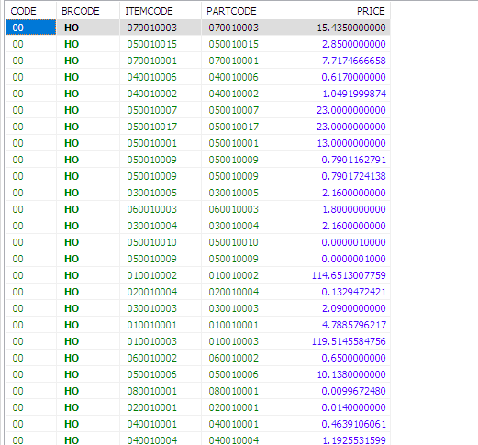
HOW TO USE VIEW?
Syntax:
SELECT * FROM ‘viewname’;
Eg:
SELECT * FROM ‘v_pricelist’;

Slide 6
DROP VIEW
DROP is used to delete view from the database which is no longer required.
SYNTAX:
DROP VIEW ‘viewname’;
Eg:
DROP VIEW ‘v_pricelist’;

Slide 7
Why Use Views?
Views increase re-usability : Can use a view multiple times. Reduce writing same query again ands gain
Views help in data security : Use views to display authorized information to the user and hide sensitive informations like credit card numbers.

Slide 8
ADVANTAGES:
1. View the data without storing the data into the object.
2. Restict the view of a table i.e. can hide some of columns in the tables.
3. Join two or more tables and show it as one object to user.
4. Restict the access of a table so that nobody can insert the rows into the table.
DISADVANTAGES:
1. Can not use DML operations on this.
2. When table is dropped view becomes inactive.. it depends on the table objects.
3. It is an object, so it occupies space.

